Slide 1
Characterizing RNA Folding
Christine Wiersma
Mentor: Dr. Wilma Olson
DIMACS REU
Rutgers University
June 5, 2015

Slide 2
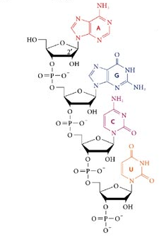
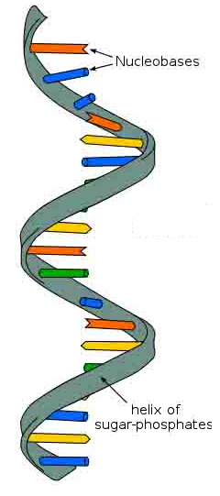
Ribonucleic Acid (RNA)
Composed of nucleotides
String of nucleotides forms single stranded helix
Helix bends and twists to create 3D structure
Rana TM. 2007. Chemical and structural features of RNA and DNA helices. Nature Reviews Molecular Cell Biology. Internet.
Organic molecules: Carbs, proteins, lipids and nucleic acids. 2015. What is Organic Chemistry? Science Prof Online. Internet

Slide 3
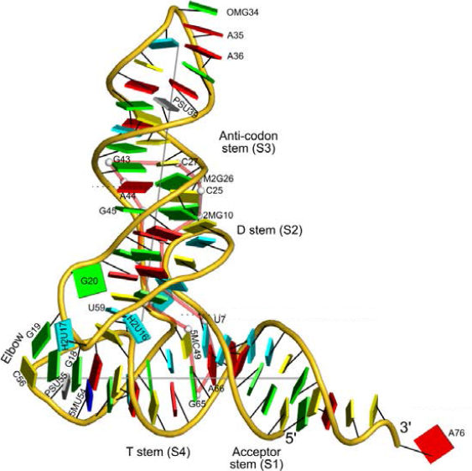
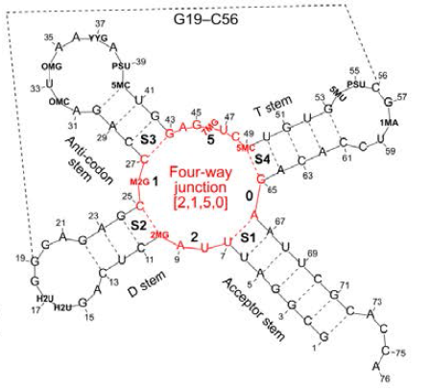
RNA Structure
Structure is important to function
Many functions
  Protein synthesis
  Genetic material (in some viruses)
Lu XJ, Bussemaker HJ, Olson WK. DSSR: an integrated software tool for dissecting the spatial structure of RNA. Preprint.
Lu XJ, Bussemaker HJ, Olson WK. DSSR: an integrated software tool for dissecting the spatial structure of RNA. Preprint.

Slide 4
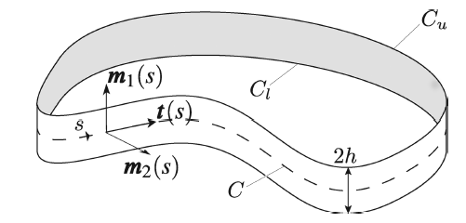
Previously Completed Research
DNA geometry and topology characterized
Standard construction is ribbon model
Clauvelin N, et al. 2012. Characterization of the Geometry and Topology of DNA Pictured as a Discrete Collection of Atoms. J. Chem. Theory Comput. 1093. Print.

Slide 5
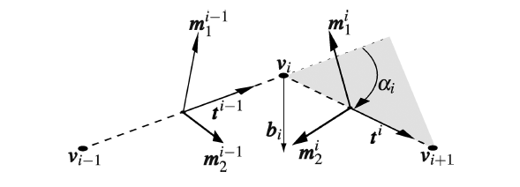
Discrete DNA Model
Compute writhing number, total twist, and linking number
Clauvelin N, et al. 2012. Characterization of the Geometry and Topology of DNA Pictured as a Discrete Collection of Atoms. J. Chem. Theory Comput. 1093. Print.

Slide 6
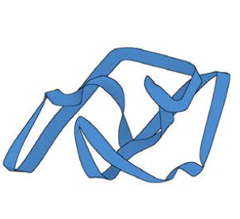
RNA Ribbon Model
DSSR software analyzes RNA tertiary structure
Able to create a ribbon structure from analysis
Lu XJ, Bussemaker HJ, Olson WK. DSSR: an integrated software tool for dissecting the spatial structure of RNA. Preprint.

Slide 7
Goals and Methods
Describe the geometry and topology of RNA
Modify previously used methods for DNA for use with RNA

Slide 8
References
Brooker RJ. 2012. Concepts of genetics. New York, NY: The McGraw-Hill Companies, Inc. 225-242 p.
Clauvelin N, Olson WK, Tobias I. 2012. Characterization of the geometry and topology of DNA pictured as a discrete collection of atoms. J. Chem. Theory Comput. 8:1092-1107.
Lu XJ, Bussemaker HJ, Olson WK. DSSR: an integrated software tool for dissecting the spatial structure of RNA. Preprint.

